Slide 1
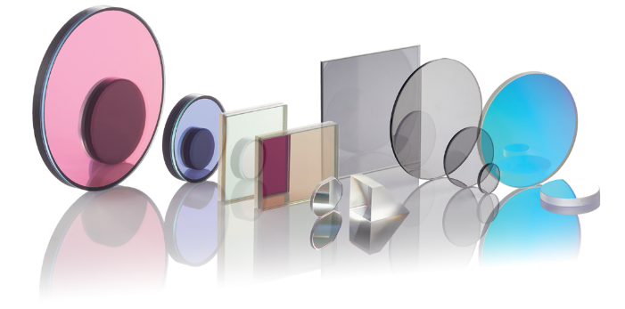

Slide 2
Why Andover?
Industry-leading customer satisfaction
Superior delivered quality with short lead times
Exceptional coating expertise
First-surface hard coat, assembled coatings, and hybrid solutions
Vertically integrated for a seamless process
For every step of the job including design, fabrication, and metrology
No program too small or too large
High-volume capacity with no minimum order quantities
Custom engineering to meet your needs
We work with every customer to develop the best possible solution

Slide 3
Reliable Partner
Complete in-house control, from design through delivery
Redundancy integrated into all critical processes
Collaborative engineering through every project stage
Vertical integration ensures consistent quality, cost-effective production, and minimal lead times
DESIGN
ENGINEERING
FABRICATION
COATING
METROLOGY
& INSPECTION
ASSEMBLY

Slide 4
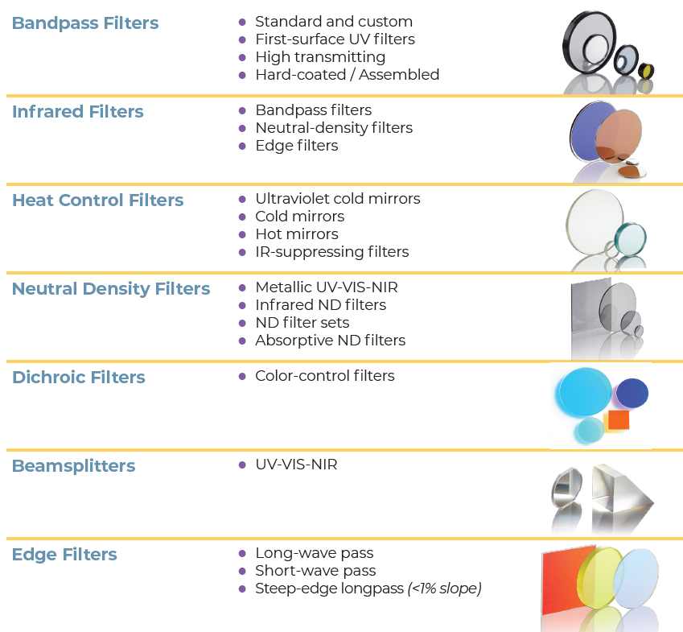
Our Standard Offering
Wavelength Range: 193nm – 15000nm
Sizes: 12.5, 25, and 50mm
custom sizes available
24/7 online ordering, no minimum quantities

Slide 5
Our Capabilities
We provide extensive coating capabilities on a wide range of substrate materials:
Our Capabilities
Optical coatings 193nm – 15000nm
Diamond-like carbon coating
Metallization
Optical accessory products
Optical assemblies
Plano polishing
Precision beveling
Dicing
Diamond milling, coring, and sawing
Substrate Materials
BK-7; H2; G-18
Fused silica; UV and IR grades
Filter glass
Chalcogenide glass
Sapphire
Germanium
Zinc sulfide
Zinc selenide
Silicon, CZ and FZ grades
Calcium Fluoride
Barium Fluoride
Magnesium Fluoride

Slide 6
18 Automated Chambers Representing Diverse Coating Technologies
Coating Technology | Coating Type | Wavelength Range (nm) | Max Diameter | Filter Construction | Durability
Magnetron Sputtering | All Filter Types | 325-5000 | 1-10”, 5-10”, 6-8” | First Surface | Severe abrasion MIL-C-48497
EB Gun and Resistance (Ion-Assisted Preclean) | Infrared Coatings | 1650-20000 | 1-10”, 5-10”, 8-9” | First Surface | Moderate abrasion MIL-F-41416
Diamond-Like Carbon | Infrared Coatings | 3000-14000 | 14” platen | First Surface | Windscreen Wiper Test: TS 1888 / P5.4.3 Severe abrasion MIL-C-675C / P4.5.10
Ion-Assisted E-Beam Deposition | UV Coatings High Laser Damage Low Stress | 240-2100 | 5-12”, 4-14”, 8-9” | First Surface | Severe abrasion MIL-C-48497
 | Neutral Density Filters | 250-14000 | 4-10” | First Surface | Moderate to severe abrasion MIL-C-48497
Thermal/ Resistance Evaporation | Ultraviolet Bandpass Aluminum Mirrors | 190-390 | 1-10” | First Surface / Laminated | Moderate abrasion MIL-C-48497
 | Visible to NIR Bandpass | 390-2400 | 1-10” | Laminated | Moderate abrasion MIL-C-48497
Notes:
Update DLC mil-spec

Slide 7
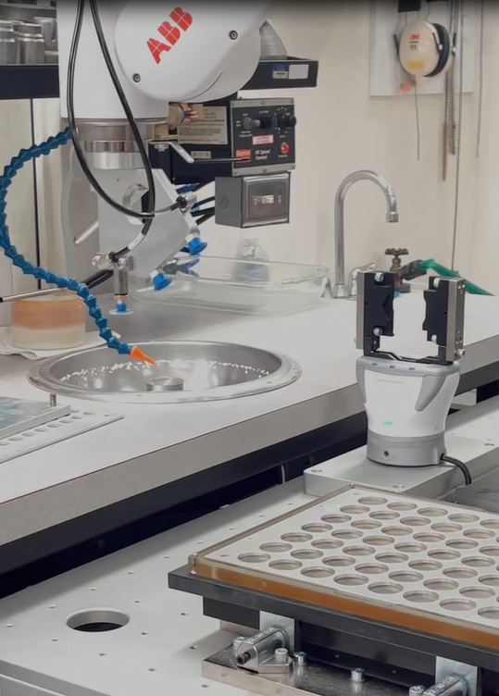
Precision High-Volume Fabrication
Automated coating chambers
Custom CNC cutting, coring, and milling cells
Robotic auto‑centering and chamfering
24/7 “lights‑out” production keeps lead times short
Redundancy on all critical process for zero downtime
Robust preventative maintenance program

Slide 8
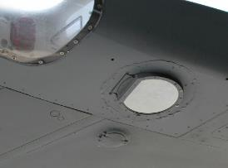
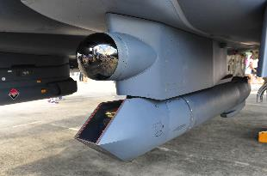
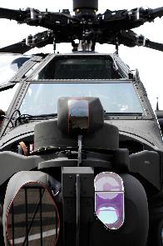
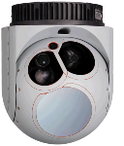
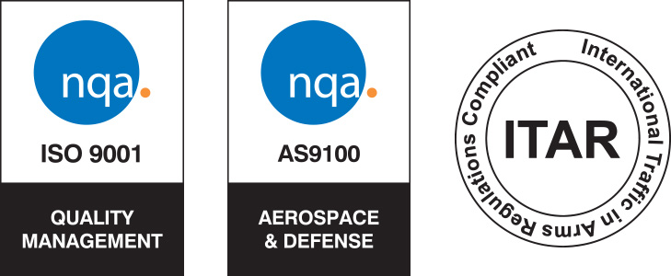
Proven Performance in Custom Optics for Defense
C-17 Landing Lights
Some of our notable programs include:
Wescam MX-Series Camera Pod
Lockheed F-16 Boresight LTAS
Lockheed F-35 JSF Program
Lockheed Sniper Advanced Targeting Pod
Lockheed Apache M-TADS/PNVS Targeting System
Boeing C-17 Landing Light Filters
RTX/Collins KC-46 Tanker / C-130
Anduril Sensors & Detectors
BAE Defense Systems
Sniper ATP
MX Pod
Apache M-TADS/PNVS

Slide 9
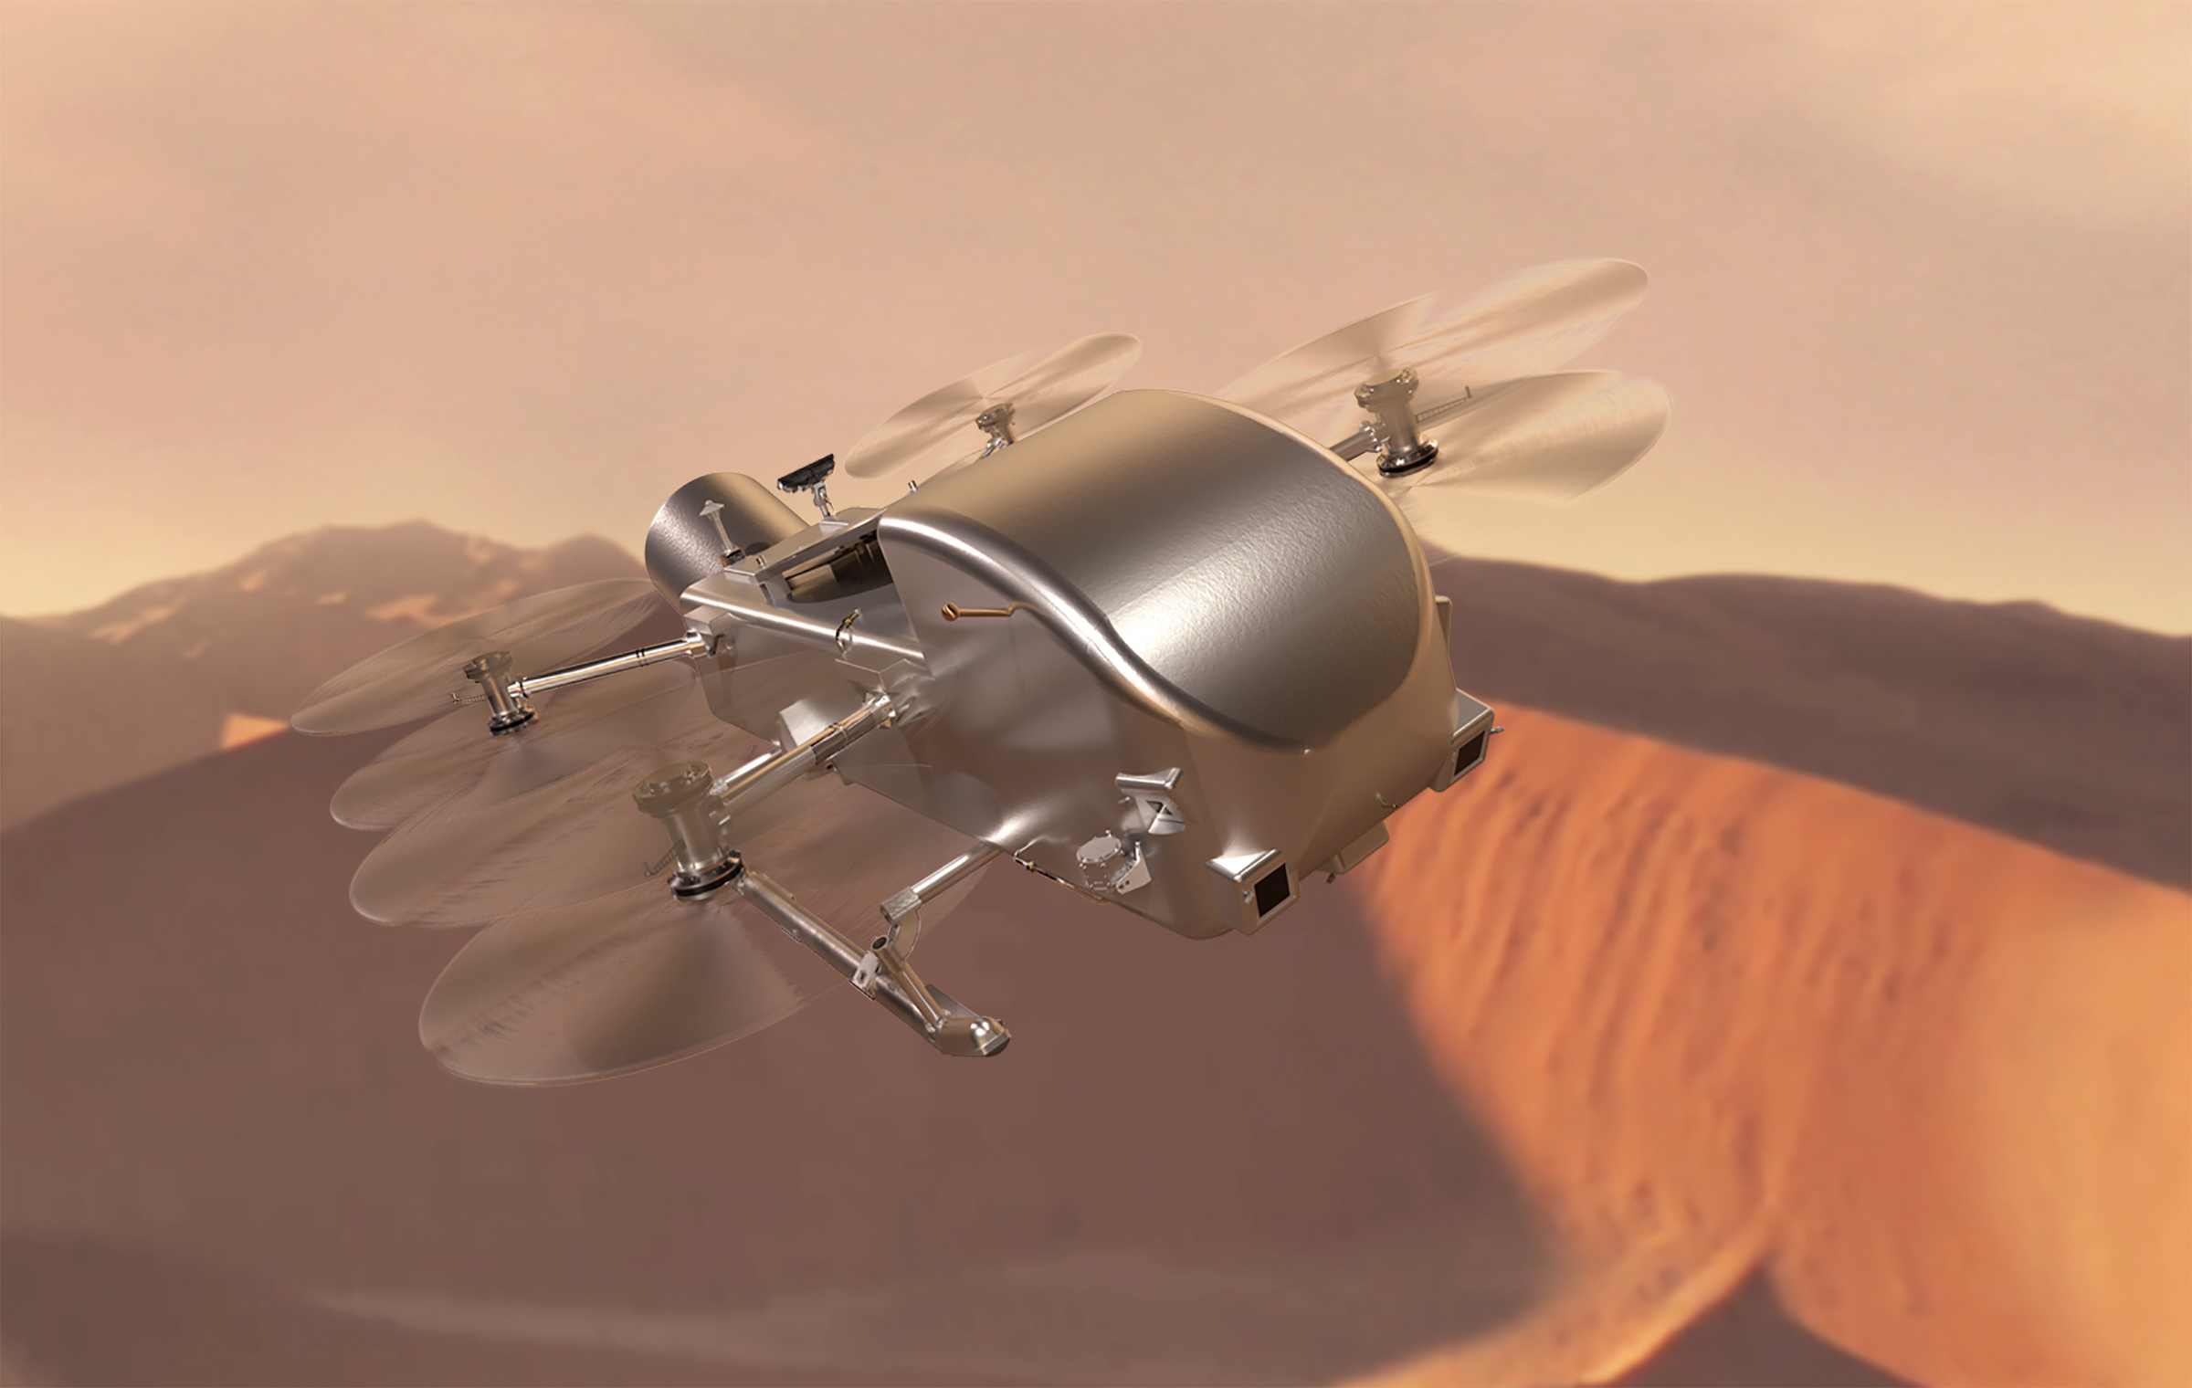
Proven Performance in Space-Qualified Custom Optics
Some of our notable projects include:
SOFIA Infrared Observatory
IR filters helped confirm lunar water in 2020
NASA/JPL Deep Space Optical Communications
Short‑wave‑pass filters enabled a 19‑million‑mile laser video link
MatISSE Mid‑IR Interferometer
Components for black‑hole & planet‑formation studies
NASA PUNCH Mission
Custom non-planar coating to suppress IR + blue light, isolating the key 600 nm band for high‑precision solar‑wind imaging
Pandora SmallSat
Filters to aid in separation of IR and VIS for spectral analysis of exoplanet atmospheres
NASA Dragonfly Mission
Color contrast filters to aid in detection of pre-biological conditions on Titan
NASA Dragonfly Mission
Notes:
Pandora Mission smallsat
PUNCH Mission
Bandpass 6000nmVIS on a lens cutting out blue.
Southwest Research
IR and blue suppression filter with excellent transmission through the remaining visible spectrum– only time we’ve done a BP filter on a lens(curved surface)

Slide 10
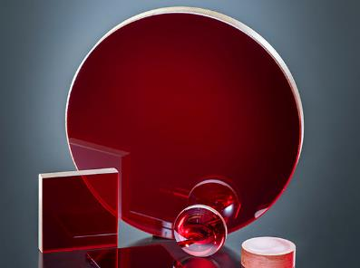
Infrared Filters and Coatings Engineered spectral control for IR imaging
Wavelength coverage from 2–15 µm (MWIR through LWIR)
Broad IR substrate menu including ZnSe, ZnS, CaF2, silicon, sapphire, and more.
Supply-chain-secure alternatives to germanium available, including chalcogenide coating services for compact IR payloads.

Slide 11
Anti-Reflective Coatings Essential for your optical performance
Reflection reduction to less than 0.1% at angles up to 50°
Broad wavelength coverage from UV to far-IR
Durable coatings with environmental stability
Custom solutions with typical lead times of 4-6 weeks
Single-layer, V-coat, and broadband AR options
Meets MIL-C-48497. We offer these filters in two standard sizes: 25 mm and 50 mm dia. Custom sizes and shapes available.

Slide 12
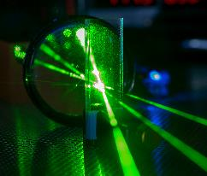
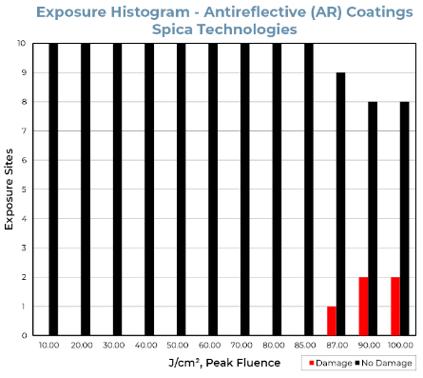
Durable Filters for Laser Systems
85 J/cm² @ 1064 nm, 10 ns pulses—zero damage at 10 sites (independent Spica test).
Certified via least‑fluence‑failure method; all data NIST‑traceable and on file for audit.
Our coatings maintain functional and structural integrity under repeated exposure to high‑power beam delivery.
Notes:
Detailed certified testing information available upon request

Slide 13
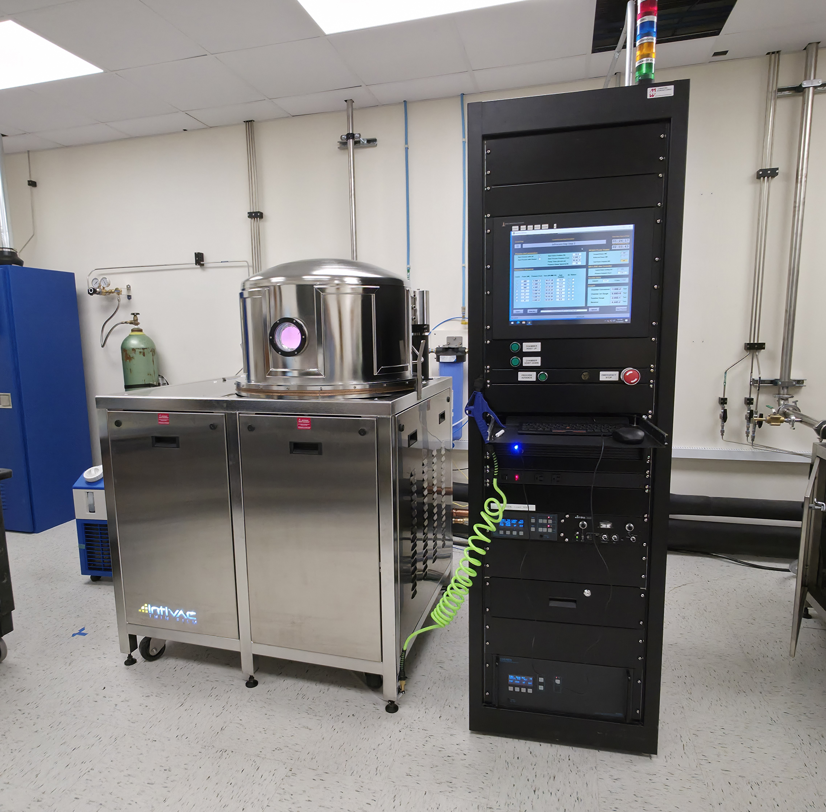
Diamond-Like Carbon Coatings
Premium AR coatings on a variety of IR substrates
Germanium
Silicon
Custom options
Unmatched durability and superior optical performance
Survives sand, salt fog, humidity, and extreme abrasion tests per MIL-F-41416
Optimized for 2-14μm applications
Extreme Environmental Resistance; withstands temperatures from -192°C to +500°C

Slide 14
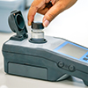
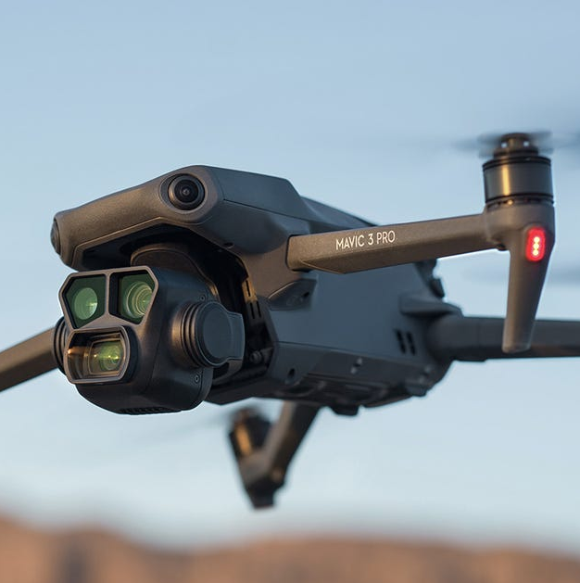
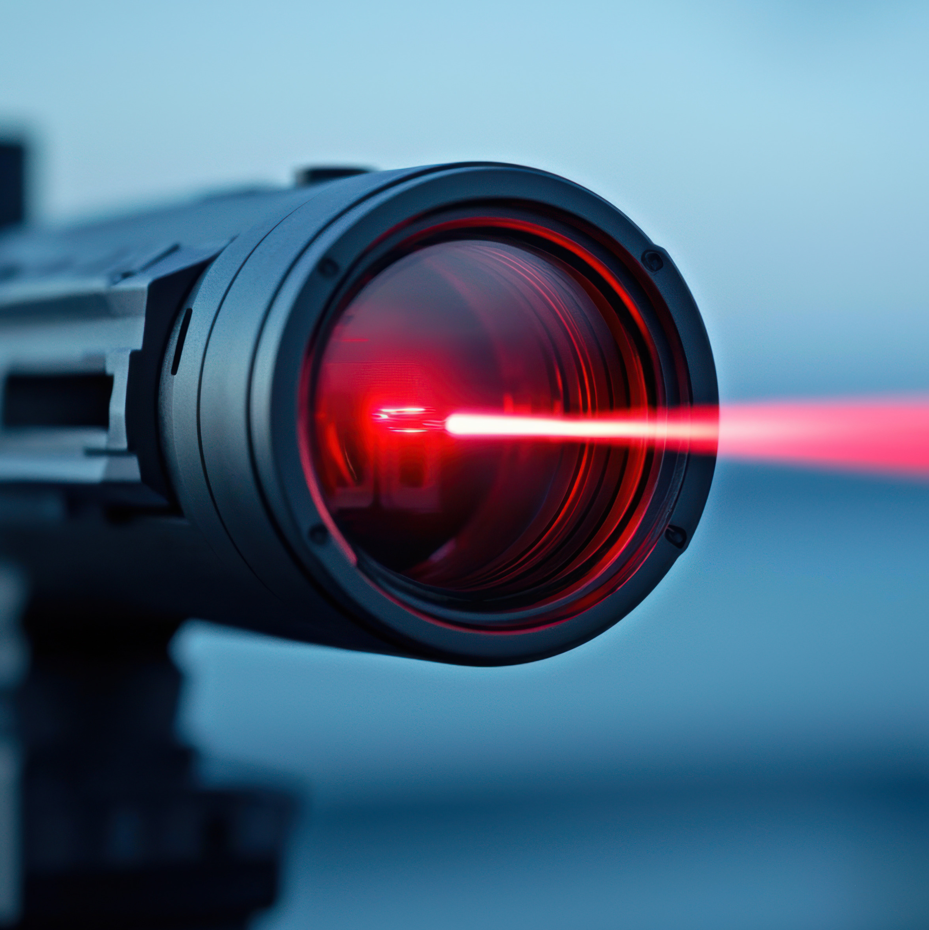
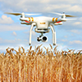
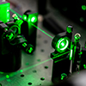
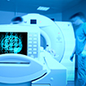
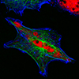

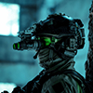
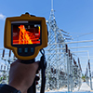
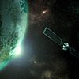
Serving Demanding Markets and Applications
Markets Served:
Defense & Aerospace
Environmental
Science & Industry
Instrumentation
Astronomy
Semiconductor
Imaging
Biotechnology
Medical Devices
Telecommunications
Universities & National Labs
Resellers & Representatives
Applications:
Surveillance & Targeting
Night Vision Systems
Environmental Monitoring
Oil/Water/Gas Analysis
Agricultural Imaging
Fluorescence Studies
Spectroscopy
Thermal Imaging
Astronomy

Slide 15
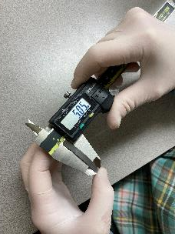
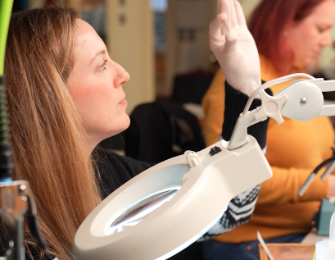
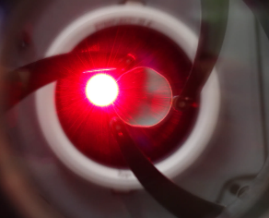
Quality Control
100% product inspection using state-of-the-art metrology
Advanced testing and inspection facilities
Standard and custom testing equipment
Return rate < 0.2%
Digital/hardcopy spectral data supplied with all optics
All manufactured parts 100% traceable via serialization/lot tracking
Environmental testing:
Temperature
Abrasion
Humidity
Solubility
Vibration
Salt fog/corrosion
Laser damage
Notes:
All manufactured parts are 100% traceable via serialization/lot tracking

Slide 16
Fast Delivery
RFQ to Quote
Same-day processed and notification to customer
Turnaround 1-3 days
Custom Runs
Avg. 3-8 weeks lead time*
Just-In-Time flexibility
Inventory
Large stock of optical-grade substrates, including:
BK7, Fused Silica, Borosilicate, B 270
IR materials on-hand including:
Germanium, Zinc Selenide, Zinc Sulfide, Silicon, Sapphire
* lead times may vary based on project specifications

Slide 17
What’s Next for Andover
New fabrication equipment
5-axis milling center
Expanded chamber capacity
3 new chambers online
Process control and testing equipment
Photolithography liftoff
Ultrasonic cleaning
Auto-centering high-speed fabrication
Sapphire / optical glasses
Exotic shapes / precision beveling

Slide 18

Thank you!
A Legacy of Quality
Focused on the Future
4 Commercial Drive • Salem, NH 03079
T: 603.893.6888 • F: 603.893.6508 • www.andovercorp.com

